Slide 1
Research on KPIs
FoodCorp Stores

Slide 2
Food Corp stores in the UK
Nottingham
London
London, Forest Road
Birmingham

Slide 3
Food Corp stores in the UK and their sizes
Nottingham (42)
London (38)
London, Forest Road (36)
Birmingham (29)

Slide 4
Growth KPIs

Slide 5
Average Transaction Value
This matrix will help us understand the spending nature of the customers in each store
Higher value would mean that either the customer is spending too much or buying stuff in more quantity
This can give us great actionable insights to improve pricing, sales tactics

Slide 6
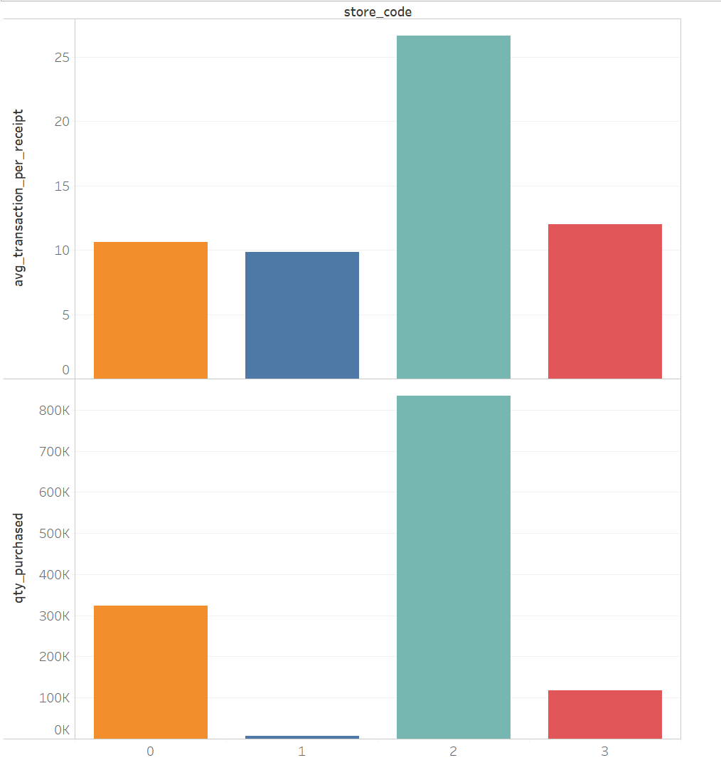

Slide 7
Active Customers
This will also help us understand the customer traffic for each store in two years
This will help us measure marketing and advertising effort we put in each store
This also determines the success of prior marketing/ promotional efforts

Slide 8
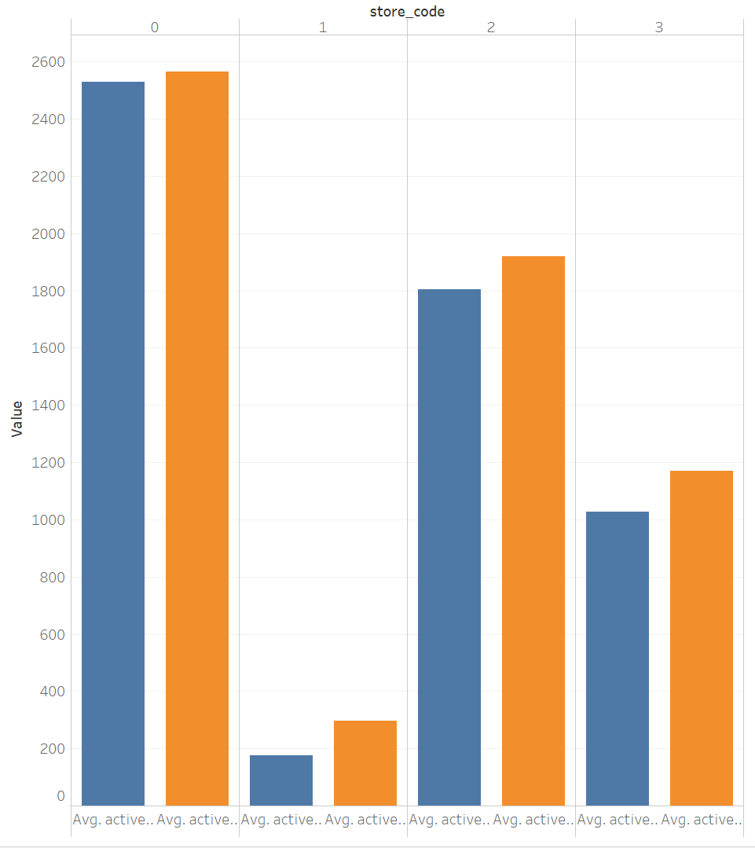

Slide 9
Customer Engagement KPIs

Slide 10
New Customers
This Matrix will help us understand how each of our store is managing to attract new customers, each month, for 2 years.
This gives us a measure of how many people are attracted to our value proposition. (eg: Prices, discounts, products, value for money)

Slide 11
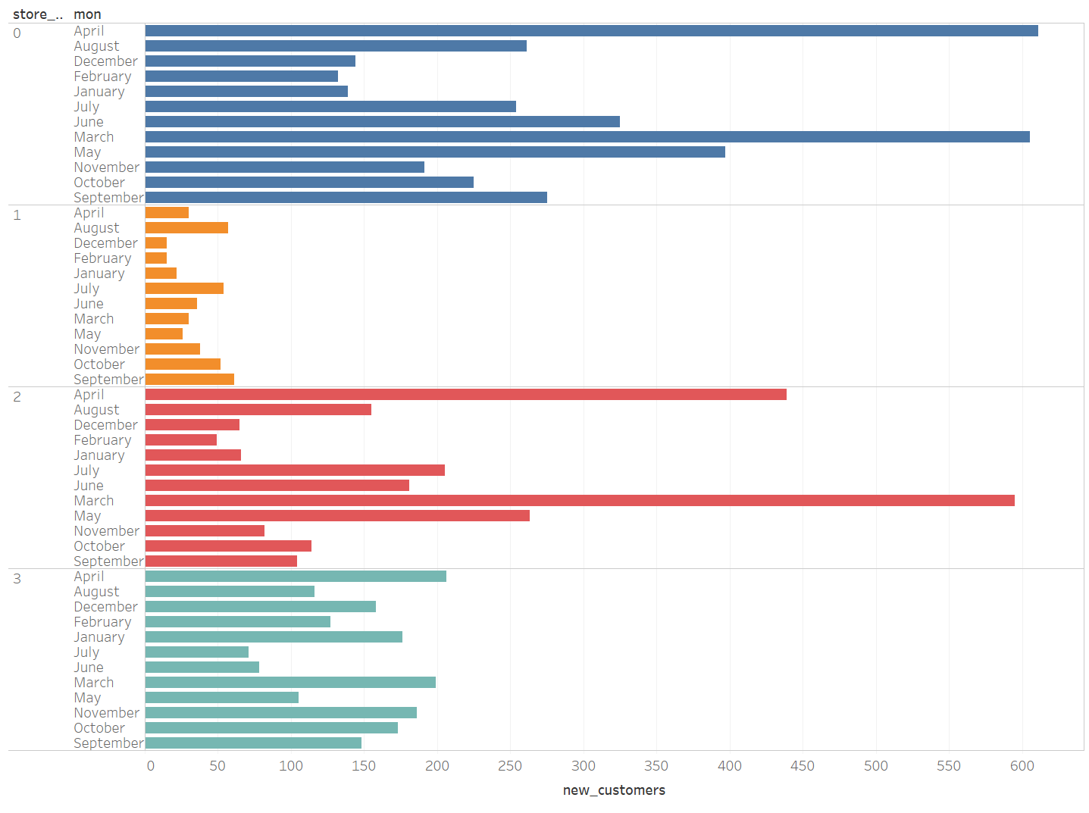

Slide 12
Repeat Customers
This Matrix helps us to understand consumer reliance or loyalty to the store
This measure can help us track back, the value prop that got these customers back to us

Slide 13
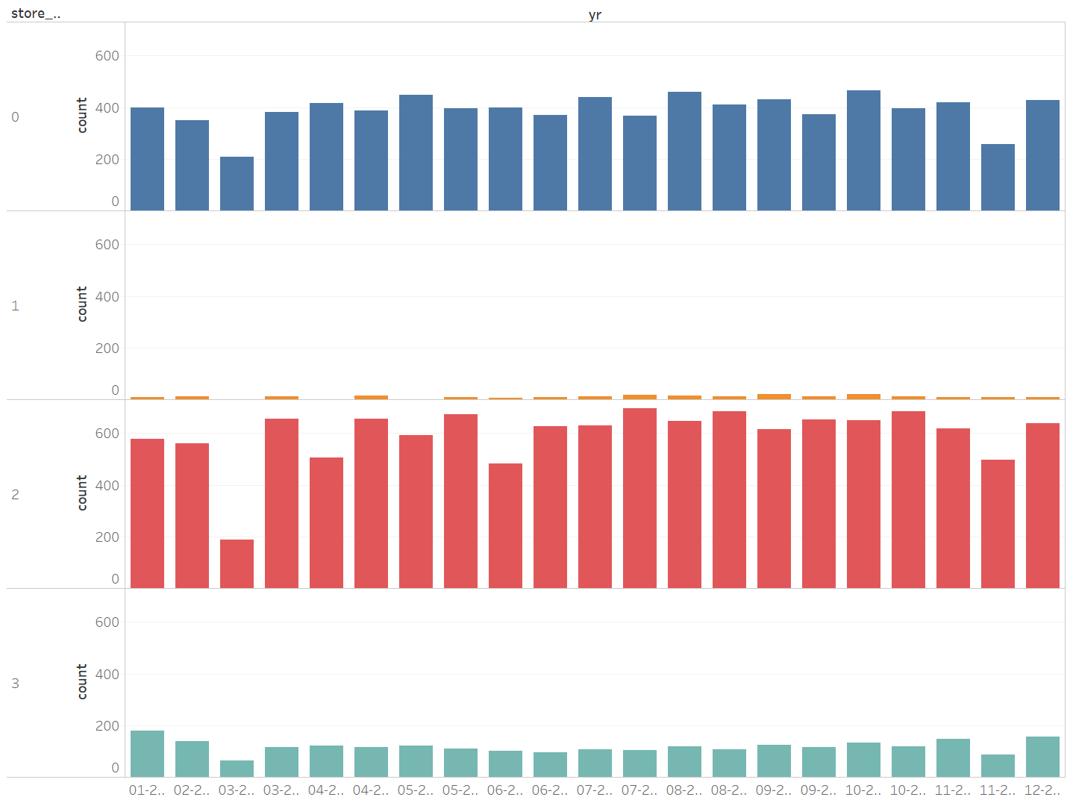

Slide 14
Customer Retention
This Matrix will give us an understanding of how many customers return to our stores
This index is a great way to gauge customer service and product performance.
Customer retention is important, because the cost of retaining is lesser than the cost of acquiring

Slide 15
